Slide 1

Pioneering Employee Well-Being with 'Bell-Being'
March 21, 2024

Slide 2
Agenda
Welcome to 'Bell-Being': Pioneering Employee Well-Being at Bell Food Group
Our Employees: The Core of Our Success
Virtual Coach: A Companion for Every Employee's Journey
Enhancing Personal Growth and Social Connections
Engagement Through Gamification: Rewards that Matter

Slide 3

Welcome to Bell-Being: Pioneering Employee Well-Being at Bell Food Group
Key Points
Welcome and introduction
Introducing the concept of 'Bell-Being' – an interactive avatar-based platform
Showcasing gamification as crucial element of ‘Bell-Being’

Slide 4
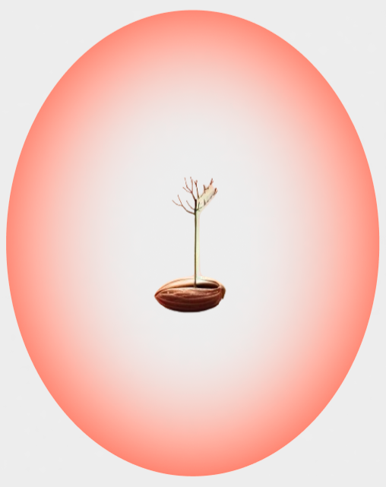







Virtual Coach: A Companion for Every Employee's Journey
Avatar: The Tree of personal development
Real-time reactions and simulations for a tailored user experience.
Enhances learning through interactive scenarios and feedback.
Builds a sense of companionship, reducing feelings of isolation.
Can show What-If Simulations

Slide 5
Enhancing Personal Growth and Social Connections
Personal Growth Benefits
Social Connections
Exploring individual benefits such as skill development, motivation through gamification, and continuous learning opportunities.
Fostering employee interactions, encouraging idea exchanges, and building a sense of community within the workforce.
Employee Engagement
Community Building
Strategies to enhance employee engagement through personal growth initiatives and creating opportunities for social interactions at the workplace.
Highlighting the importance of a supportive work environment that promotes collaboration, inclusivity, and a sense of belonging among employees.

Slide 6
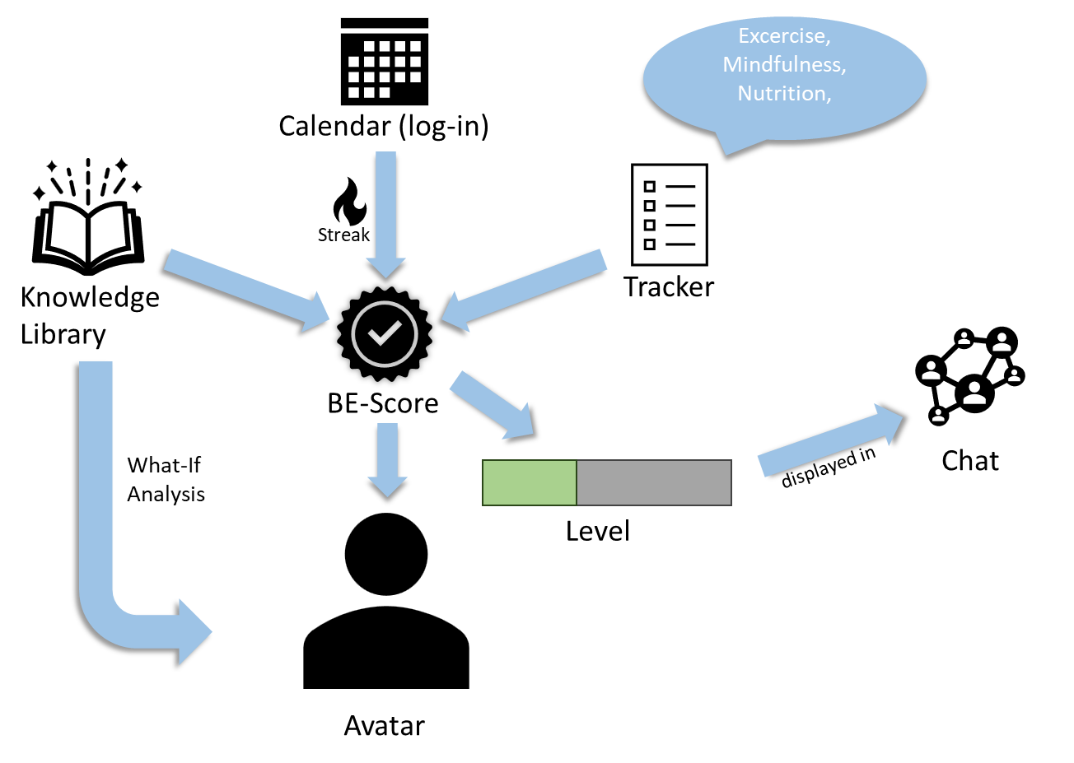
Engagement Through Gamification: Rewards that Matter
Gamification and Recognition
Showcasing how active participation is rewarded to motivate employees
Highlighting potential incentives such as events, recognitions, and wellness retreats
Encouraging employees to start their journey the knowledge library offers insights with 3-5 min articles including tips & tricks for day-to-day life

Slide 7
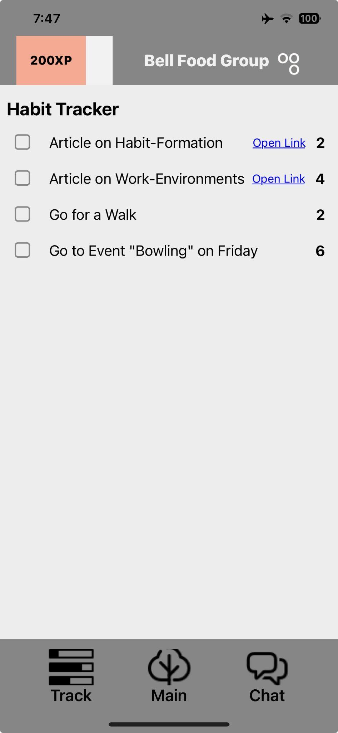
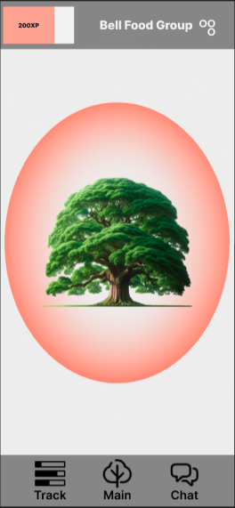
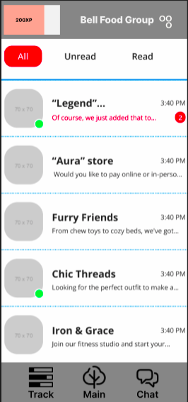
Implementation

Slide 8


Thank you

